Slide 1
Network Security
CS 6823 – Lecture 6
Message Integrity, PKI, SSL, and IPSec
Phillip Mak
pmak@nyu.edu

Slide 2
Lesson Objectives
Understand how nonces improves authentication
Understand how RSA, DH, AES are the backbone of Internet communications
Apply modern crypto concepts to solve scenarios
Understand how PKI certificates are issues and used
Explain Perfect Forward Security
Understand protocol level details of a TLS connection
Identify vulnerabilities and issues in PKI/TLS systems

Slide 3
Message Integrity and Digital Signatures

Slide 4
Message Integrity
Allows communicating parties to verify that received messages are authentic.
Content of message has not been altered
Source of message is who/what you think it is
Message has not been artificially delayed (playback attack)
Sequence of messages is maintained
Let’s first talk about message digests

Slide 5
Encryption vs. Hashing
PlainText
CipherText
Message
Encryption( )
or
Hash
Decryption( )
Message Digest
Encryption keeps communications private
Encryption and decryption can use same or different keys
Achieved by various algorithms, e.g. DES, CAST
Need key management
Hash transforms message into fixed-size string
One-way hash function
Strongly collision-free hash
Message digest can be viewed as “digital fingerprint”
Used for message integrity check and digital certificates
Hash is generally faster than encryption

Slide 6
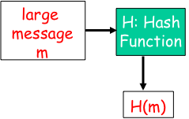
Message Digests
Function H( ) that takes as input an arbitrary length message and outputs a fixed-length string: “message signature”
Note that H( ) is a many-to-1 function
H( ) is often called a “hash function”
Desirable properties:
Easy to calculate
Irreversibility
Collision resistance: Computationally difficult to produce m and m’ such that H(m) = H(m’)
Seemingly random output

Slide 7
Hash Function Algorithms
MD5 hash function widely used (RFC 1321)
computes 128-bit message digest in 4-step process.
Usually represented as 32 HEX digits
SHA-1 is also used (sometimes just called SHA)
US standard [NIST, FIPS PUB 180-1]
160-bit message digest
kobrien-laptop:~ kobrien$ echo "test" | md5sum
d8e8fca2dc0f896fd7cb4cb0031ba249 -
kobrien-laptop:~ kobrien$ echo "test" | md5sum
d8e8fca2dc0f896fd7cb4cb0031ba249 -
kobrien-laptop:~ kobrien$ echo "test1" | md5sum
3e7705498e8be60520841409ebc69bc1 -
kobrien-laptop:~ kobrien$ echo "test1" | md5sum
3e7705498e8be60520841409ebc69bc1 -

Slide 8
Commonly Used Hash Functions (MD5 and SHA)
Both MD5 and SHA are derived based on MD4
MD5 provides 128-bit output, SHA provide 160-bit output, (only first 96 bits used in IPSec)
Both of MD5 and SHA are considered one-way strongly collision-free hash functions
SHA is computationally slower than MD5, but more secure
MD5, SHA1 not collision resistant
Relevance to non-repudiation, commitment

Slide 9
So What Does This Mean?
SHA1 is still much safer than MD5
Best known attack has effort > 2^64
HMAC SHA1 (keyed SHA1) believed to be unaffected by current attacks
Industry making a move towards SHA256 (SHA2) and other secure crypto methods
Actual transition will take place within standard groups first
IETF and NIST among others addressing this issue

Slide 10
Security Level of Crypto Algorithms
Security Level | Work Factor | Algorithms
Weak | O(2⁴⁰) | DES, MD5
Legacy | O(2⁶⁴) | RC4, SHA1
Minimum | O(2⁸⁰) | 3DES, SEAL, SKIPJACK
Standard | O(2¹²⁸) | AES-128, SHA-256
High | O(2¹⁹²) | AES-192, SHA-384
Ultra | O(2²⁵⁶) | AES-256, SHA-512

Slide 11
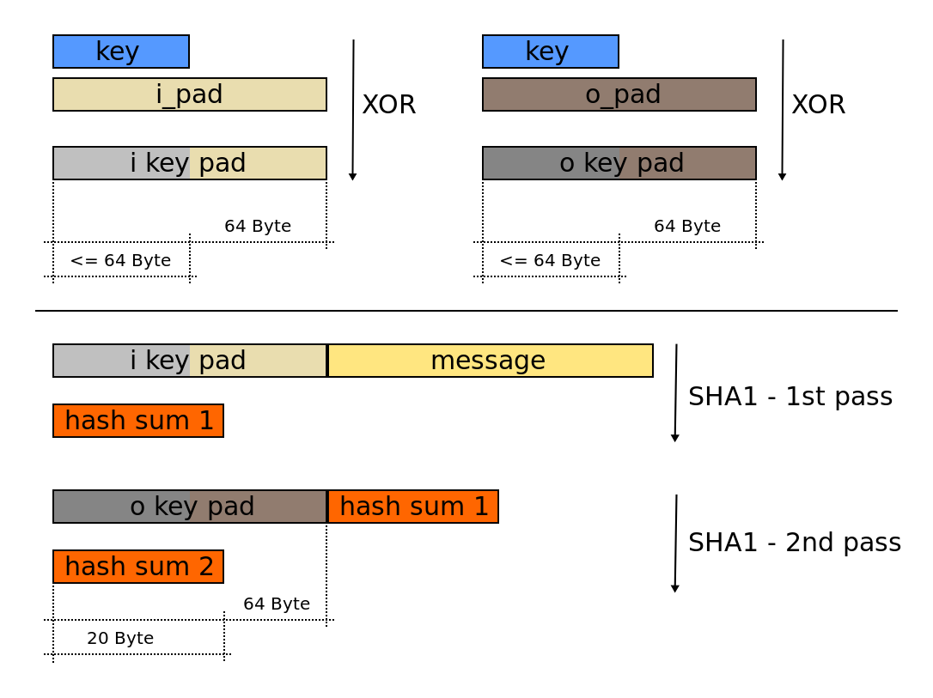
Hash-Based Message Authentication Code (HMAC)
opad and ipad are constants
Authenticates sender
Verifies message integrity
No encryption!
Also called “keyed hash”
Source: Wikipedia

Slide 12
End Point Authentication
Want to be sure of the originator of the message – end-point authentication.
Assuming Alice and Bob have a shared secret, will MAC provide message authentication.
We do know that Alice created the message.
But did she send it?

Slide 13
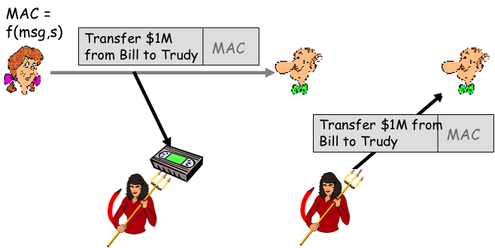
Playback Attack
Bob cannot distinguish between the original communication and the later playback
Problem is that the shared secret is used over and over

Slide 14
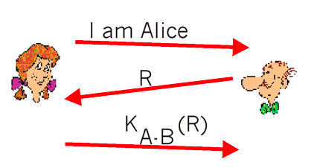
Defending Against Playback Attack: Nonce
1) Alice sends the message, “I am Alice,” to Bob
2) Bob chooses a nonce, R, and sends it to Alice
3) Alice encrypts the nonce using Alice and Bob's symmetric secret key, K_{A-B}, and sends the encrypted nonce, K_{A-B} (R) back to Bob.
A nonce is a number that a protocol will only ever use once-in-a-lifetime

Slide 15
Nonce (con’t)
It is the fact that Alice knows K_{A-B} and uses it to encrypt a value that lets Bob know that the message he receives was generated by Alice.
The nonce is used to ensure that Alice is "live." Bob decrypts the received message. If the decrypted nonce equals the nonce he sent Alice, then Alice is authenticated.

Slide 16
Public Key Infrastructure (PKI)

Slide 17
PKI: IKE Authentication Architecture
Registration and Certification Issuance
Certificate Authority
Key Recovery
Certificate Revocation
Key Generation
Certificate Distribution
Trusted Time Service
Key Storage
Support for Non-Repudiation
PKI is an infrastructure for numerous services that work together to enable interoperability of digital certificates

Slide 18
Digital Signatures
Private
Public
Entity authentication
Data origin authentication
Integrity
Non-repudiation

Slide 19
Digital Signatures
One-Way Function; Easy to Produce Hash from Message, “Impossible” to Produce Message from Hash
Message
Hash
Function
Alice
Hash of Message
s74hr7sh7040236fw
7sr7ewq7ytoj56o457
Sign Hash with Private Key
Signature = “Encrypted” Hash of Message
Notes:
A digital signature is an application in which the signer, “signs” a message in such a way that anyone can verify that the message was signed byno one but the sender, and consequently that the message has not been modified since it was signed.
A digital signature usually involves a message-digest algorithm and a public-key (asymmetric) algorithm for encrypting the message digest.
The entire message need not be signed.
By using a one-way function—such as a hash function—it is possible to digest the entire message into a small string.
The hash of the message can produces the digest, but given a digest, it is impossible to determine what the message was.
Minute changes in message—added white space, lowercase letter changed to uppercase—will have demonstrable impact on digest
Digest is signed and transmitted with message

Slide 20
Signature Verification
Message
Decrypt the Received Signature
Re-Hash the Received Message
Message
Signature
Signature
Message with Appended Signature
Hash
Function
Decrypt Using Alice’s Public Key
Alice
Hash of Message
Hash Message
If Hashes Are Equal, Signature Is Authentic
Notes:
Upon receipt of a signed message, the digest is reproduced, and the signature is verified against this digest.

Slide 21
Digital Signatures (more)
Alice thus verifies that:
Bob signed m.
No one else signed m.
Bob signed m and not m’.
Non-repudiation:
Alice can take m, and signature K_{B}(m) to court and prove that Bob signed m.
Not really to court; current laws don’t allow that
Doesn’t stop Trudy from replaying message m

Slide 22
Public Key Certifcation
Motivation: Trudy plays pizza prank on Bob
Trudy creates e-mail order: Dear Pizza Store, Please deliver to me four pepperoni pizzas. Thank you, Bob
Trudy signs order with her private key
Trudy sends order to Pizza Store
Trudy sends to Pizza Store her public key, but says it’s Bob’s public key.
Pizza Store verifies signature; then delivers four pizzas to Bob.
Bob doesn't even like Pepperoni

Slide 23
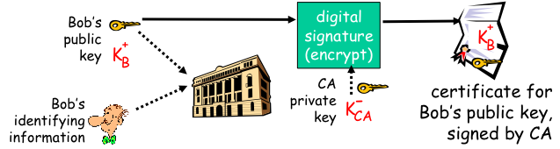
Certificate Authorities
Certification authority (CA): binds public key to particular entity, E.
E (person, router) registers its public key with CA.
E provides “proof of identity” to CA.
CA creates certificate binding E to its public key.
certificate containing E’s public key digitally signed by CA – CA says “this is E’s public key”

Slide 24
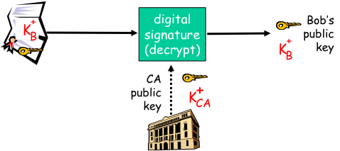
Certificate Authorities
When Alice wants Bob’s public key:
gets Bob’s certificate (Bob or elsewhere).
apply CA’s public key to Bob’s certificate, get Bob’s public key

Slide 25
X.509 v3 Certificate
Version
Serial Number
Signing Algorithm,
e.g. SHA1withRSA
Signature Algorithm ID
Issuer (CA) X.500 Name
CA’s Identity
Validity Period
Lifetime of this Cert
Subject X.500 Name
User’s Identity, e.g. cn, ou, o
Subject Public
Key Info
Algorithm ID
User’s Public Key (Bound
to User’s Subject Name)
Public Key Value
Issuer Unique ID
Subject Unique ID
Other User Info,
e.g. subAltName, CDP
Extension
CA Digital Signature
The certificate is signed by the parent CA’s Private Key

Slide 26
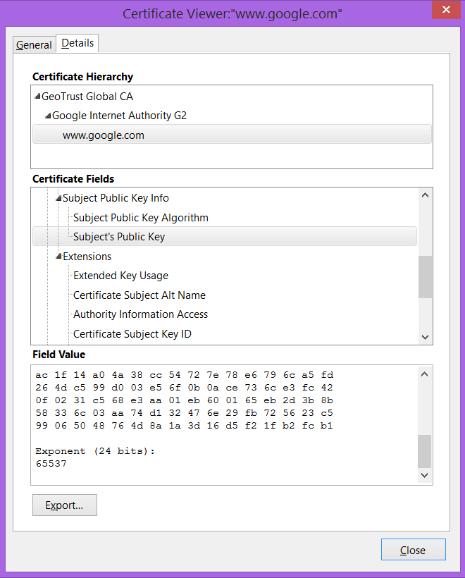
Example X.509 Certificate
Certificate:
Data:
Version: 1 (0x0)
Serial Number: 7829 (0x1e95)
Signature Algorithm: md5WithRSAEncryption
Issuer: C=ZA, ST=Western Cape, L=Cape Town, O=Thawte Consulting cc,
OU=Certification Services Division,
CN=Thawte Server CA/emailAddress=server-certs@thawte.com
Validity
Not Before: Jul 9 16:04:02 1998 GMT
Not After : Jul 9 16:04:02 1999 GMT
Subject: C=US, ST=Maryland, L=Pasadena, O=Brent Baccala,
OU=FreeSoft, CN=www.freesoft.org/emailAddress=baccala@freesoft.org
Subject Public Key Info:
Public Key Algorithm: rsaEncryption
RSA Public Key: (1024 bit)
Modulus (1024 bit):
00:b4:31:98:0a:c4:bc:62:c1:88:aa:dc:b0:c8:bb:
33:35:19:d5:0c:64:b9:3d:41:b2:96:fc:f3:31:e1:
66:36:d0:8e:56:12:44:ba:75:eb:e8:1c:9c:5b:66:
70:33:52:14:c9:ec:4f:91:51:70:39:de:53:85:17:
16:94:6e:ee:f4:d5:6f:d5:ca:b3:47:5e:1b:0c:7b:
c5:cc:2b:6b:c1:90:c3:16:31:0d:bf:7a:c7:47:77:
8f:a0:21:c7:4c:d0:16:65:00:c1:0f:d7:b8:80:e3:
d2:75:6b:c1:ea:9e:5c:5c:ea:7d:c1:a1:10:bc:b8:
e8:35:1c:9e:27:52:7e:41:8f
Exponent: 65537 (0x10001)
Signature Algorithm: md5WithRSAEncryption
93:5f:8f:5f:c5:af:bf:0a:ab:a5:6d:fb:24:5f:b6:59:5d:9d:
92:2e:4a:1b:8b:ac:7d:99:17:5d:cd:19:f6:ad:ef:63:2f:92:
ab:2f:4b:cf:0a:13:90:ee:2c:0e:43:03:be:f6:ea:8e:9c:67:
d0:a2:40:03:f7:ef:6a:15:09:79:a9:46:ed:b7:16:1b:41:72:
0d:19:aa:ad:dd:9a:df:ab:97:50:65:f5:5e:85:a6:ef:19:d1:
5a:de:9d:ea:63:cd:cb:cc:6d:5d:01:85:b5:6d:c8:f3:d9:f7:
8f:0e:fc:ba:1f:34:e9:96:6e:6c:cf:f2:ef:9b:bf:de:b5:22:
68:9f

Slide 27
PKI Certificate Authority Example
GeoTrust Global Root CA
GeoTrust Intermediary CA 1
GeoTrust Intermediary CA 2
Google Internet Authority G2
www.google.com
Website 1
Website 2
Root CA
Typically loaded into the browser
Intermediary CA
Typically on the webserver and cached by browser
SSL Certificate
Sent with the website when SSL/TLS begins

Slide 28
PKI Certificate Authority Example
Your browser trusts GeoTrust Root CA Implicitly
GeoTrust Root CA trusts Google Internet Authority G2
Google Internet Authority G2 trusts www.google.com
∴ therefore you trust www.google.com
Root CA certificates are pre-installed with browsers
A web browser will not trust a certificate if it’s not installed and trusted by a Root CA
However, the browser will trust anything the Root CA trusts
Browser will check the following:
Check the Common Name (CN) is www.google.com
Check the Certificate Revocation List (CRL) for each CA (not actually done)
Check the Validity dates “not before” and “not after”

Slide 29
Certificate Issuance
User goes to Certificate Authority to request a certificate
Verisign, GeoTrust, et al. for SSL/TLS and email
Apple, Microsoft for code signing
Authority performs business and technical checks on the requester (usually pretty minimal)
CA generates and issues certificate (usually through an Intermediary CA)
There is no standard on who becomes a CA
Trust of a root CA depends on browsers/OS.
Firefox, Chrome, Microsoft, and Apple have different trusted root CAs
Companies routinely run their own CAs for encrypted email
Multiple certificates can be issued for the same Subject
E.g., google and Microsoft have had CA issue unauthorized certs, allowing man-in-the-middle attacks

Slide 30
Certificate Validation
When a browser visits a TLS site, the certificate needs to be validated
How is a certificate validated?
Browser downloads server’s cert
The cert is usually sent by server
Browser checks if the certificate is valid
Subject Alternative Name (SAN) is correct
E.g., www.google.com
Date is between “Valid from” and “Valid to”
Check if the certificate has been revoked (various methods)
If the cert is or is not for a CA
Basic Constraints, Subject Type=CA
Only CAs are allowed to issue certs, that is, the www.google.com cert is not supposed to be issuing certificates
Check that the signature is valid
Many others
Repeat until the browser gets to the trusted Root CA in the certificate store
There were numerous exploitable bugs with certificate validation due to the number of implementation errors

Slide 31
SSL/TLS

Slide 32
TLS: Transport Layer Security
New name for SSL: Secure Sockets Layer
Works on top of TCP
Widely deployed security protocol
Supported by all browsers and web servers
Enables Internet commence
Originally designed by Netscape in 1993
Number of variations:
TLS: transport layer security, RFC 2246
Goal is create a tunnel over TCP that can carry any TCP data
Available to all TCP applications
Secure socket interface
Provides
Confidentiality, Integrity, Authentication, Non-Repudiation

Slide 33
TLS History
March 2013
95
96
99
2006
2008
Initial Design
SSLRef 2.0
SSL v3.0
TLS Draft
SSL v2.0
SSL BOF
@ IETF
SSL BOF II
@ IETF
TLS v1.0
TLS v1.1
TLS v1.2
TLS v1.3 Draft
Independent Implementations
Hardware, Toolkits, Applications
Netscape
IETF

Slide 34
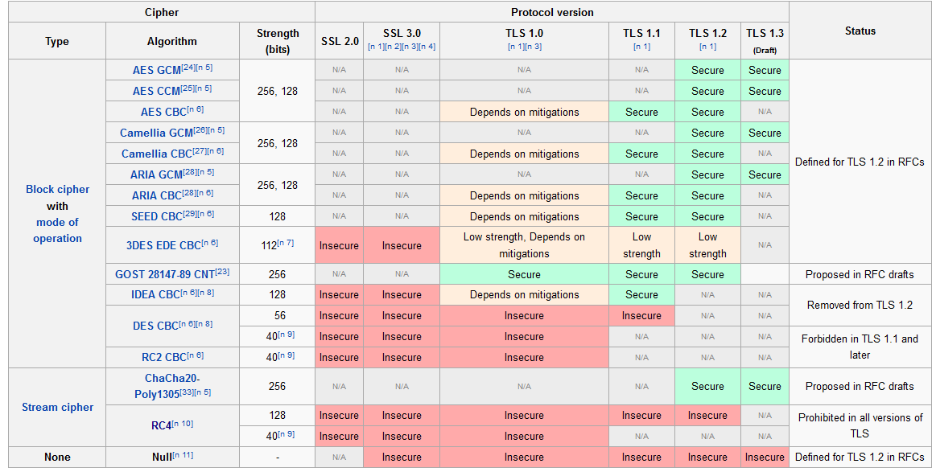
TLS Cipher Strength
From Wikipedia Oct 2015. There are a lot of caveats to each protocol/cipher

Slide 35

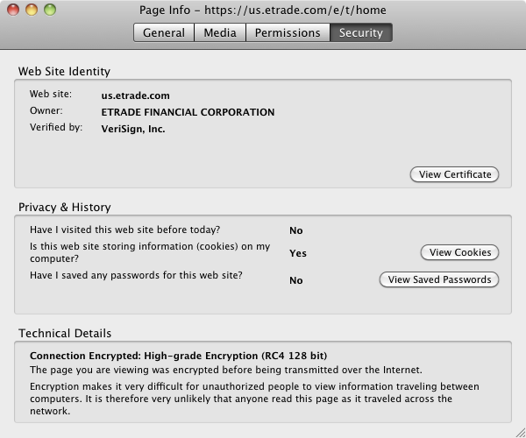
SSL Extended Validation Cert
EV SSL Certs are technically just as secure as regular certs, but for EV, the CA has performed additional business checks

Slide 36
SSL Overview
Establish a TCP connection
Client specifies to server specifications of SSL that it can support
Server picks the specifications to use
Server sends to client its certificate for the client verifies server certificate
Client verifies that server is indeed amazon.com
Compute shared symmetric key
Begin secure communications

Slide 37
Secure Sockets Layer Protocol
SSL is designed to operate in a number of different modes, depending on the requirement of the network connection
No authentication, no encryption
Authentication without encryption
Encrypted communication only
Encryption and authentication of the server (most common)
Encryption and authentication of client and server

Slide 38
SSL Benefits
Create a tunnel over TCP for any data
Ensure an attacker can’t change data arbitrary
Ensure an attacker can’t see some of the data
Attacker can still see what sites and traffic frequency
Attacker can see parts of the page not encrypted
Attacker can break the TCP connection by sending TCP Resets, but it can be detected

Slide 39
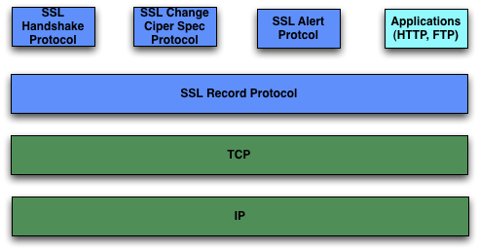
SSL Architecture
SSL Data is split into “records”

Slide 40
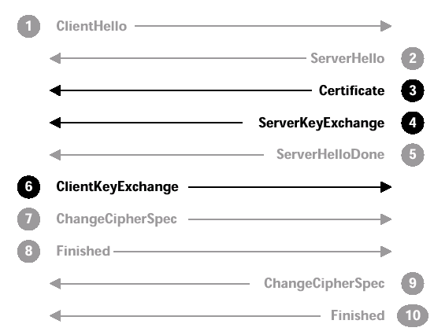
SSL Full Handshake
CLIENT SIDE
SERVER SIDE
OFFER CIPHER SUITE
MENU TO SERVER:
Version
Ciphersuite
Compression
Client Random
Session ID (only for resumption)
Options
SELECT A CIPHER SUITE
Session ID to use
SEND SERVER CERTIFICATE
(Public Key)
KEY EXCHANGE VALUES
(for ephemeral key exchanges)
SEND ENCRYPTED
SYMMETRIC KEY
SERVER NEGOTIATION
FINISHED
ACTIVATE
ENCRYPTION
Cryptograph checksum of all previous handshake messages; protects against MITM
( SERVER CHECKS OPTIONS )
ACTIVATESERVER
ENCRYPTION
( CLIENT CHECKS OPTIONS )
SERVER PORTION
DONE
NOW THE PARTIES CAN USE SYMMETRIC ENCRYPTION

Slide 41
Session Resumption
Client/Server simply send a new Hello message
Using the Master key already established, new per connections keys can be created using the new ClientRandom and ServerRandom
Server and Client send Finished messages do complete the resumption
Session resumption is used to avoid expensive initial handshake process
Just by transferring new random values server and client established new set of keys using the existing master key
Also see, Version Rollback attack

Slide 42
SSL Abbreviated Handshake
CLIENT SIDE
SERVER SIDE
OFFER CIPHER SUITE
MENU TO SERVER:
Version
Ciphersuite
Compression
Client Random
Session ID (only for resumption)
Options
SERVER CONFIRMS SESSION ID FOR RESUMPTION
ACTIVATESERVER
ENCRYPTION
SERVER NEGOTIATION
FINISHED
ACTIVATE
ENCRYPTION
Cryptograph checksum of all previous handshake messages; protects against MITM
( SERVER CHECKS OPTIONS )
NOW THE PARTIES CAN USE SYMMETRIC ENCRYPTION

Slide 43
SSL Cipher Suite
For public-key, symmetric encryption and certificate verification we need
Key exchange algorithm
Symmetric encryption algorithm
Message digest (hash) algorithm
This collection is called a cipher suite
SSL supports a variety of cipher suites
Client and server must agree upon a common suite
The client offers a choice; the server picks one.
43

Slide 44
Perfect Forward Secrecy
If a key is compromised, only the specific session it protected will be revealed to an attacker. The security of previous or future encrypted sessions is not affected.
Keys are securely deleted after use. Without these keys, there is no way captured cipher text can be decrypted.
This is called perfect forward secrecy.
Bit of a misnomer – Actually computational forward secrecy.

Slide 45
Common Types of Keys (Examples)
Key Exchange and Authentication Protocols
RSA
Client encrypts random secret key with server’s RSA key in certificate
DH_RSA (fixed Diffie-Hellman)
Uses DH keys A, g, n included in the server’s certificate
Server uses the same “A” each time (specified in the certificate)
Signed with server’s RSA public key
DHE_RSA (Ephemeral Diffie-Hellman)
Diffie-Hellman Ephemeral signed by the server RSA key in cert
Ephemeral means a, b is generated new each time
This is the Diffie-Hellman we learned in class
Signed with server’s RSA public key
ECDHE_RSA
Variant DHE_RSA except uses the Ecliptic Curve concept of DH
Symmetric Protocols
RC4, AES, DES
Hashing Protocols
MD5, SHA
Full list at https://www.openssl.org/docs/apps/ciphers.html

Slide 46
Example Cipher Suites
KEY-EXCHANGE & AUTHENTICATION
ALGORITHM
INITIAL (NULL) CIPHER SUITE
SYMMETRIC
ALGORITHM
CIPHER SUITE CODES USED
IN SSL MESSAGES
SSL_NULL_WITH_NULL_NULL = { 0, 0 }
SSL_RSA_WITH_NULL_MD5 = { 0, 1 }
SSL_RSA_WITH_NULL_SHA = { 0, 2 }
SSL_RSA_EXPORT_WITH_RC4_40_MD5 = { 0, 3 }
SSL_RSA_WITH_RC4_128_MD5 = { 0, 4 }
SSL_RSA_WITH_RC4_128_SHA = { 0, 5 }
SSL_RSA_EXPORT_WITH_RC2_CBC_40_MD5 = { 0, 6 }
SSL_RSA_WITH_IDEA_CBC_SHA = { 0, 7 }
SSL_RSA_EXPORT_WITH_DES40_CBC_SHA = { 0, 8 }
SSL_RSA_WITH_DES_CBC_SHA = { 0, 9 }
SSL_RSA_WITH_3DES_EDE_CBC_SHA = { 0, 10 }
TLS_ECDHE_RSA_WITH_AES_128_GCM_SHA256 = { 192 , 46 };
Example:
TLS_DHE_RSA_WITH_AES_128_CBC_SHA
Diffie-Hellman Ephemeral key exchange
Key exchange signed with RSA private keys for purpose of authentication
Symmetric (bulk) encryption is AES 128-bits using CBC mode
Hashing algorithm is SHA1
HASH
ALGORITHM

Slide 47
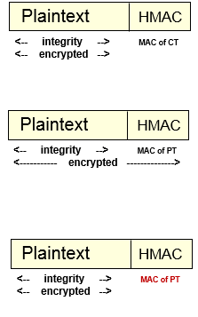
Encrypt then HMAC or HMAC then Encrypt?
HMAC is keyed-hash
Encrypt then HMAC (best)
Encrypt the message first, then append the MAC of the ciphertext
MAC provides integrity on the cipertext
Host first checks MAC before continuing processing
Bad data is dropped before reaching the decryption engine
HMAC then Encrypt (What SSL uses)
MAC the plaintext, then encrypt everything
MAC provides integrity on the plaintext
Hosts decrypts ciphertext first, then checks integrity
Decryption engine is exposed to attacker can be fed false data
Encrypt and HMAC
Append the MAC of the plaintext to the ciphertext
No integrity on the ciphertext
Has known choosen-plaintext attacks
Host does not check MAC before decrypting

Slide 48
SSL - Integrity
Compute fixed length Message Authentication Code (HMAC)
Includes hash of message
Shared secret
Sequence number
Transmit this HMAC with the message
TLS uses MD5, SHA-1
TLS 1.2 only uses SHA256+

Slide 49
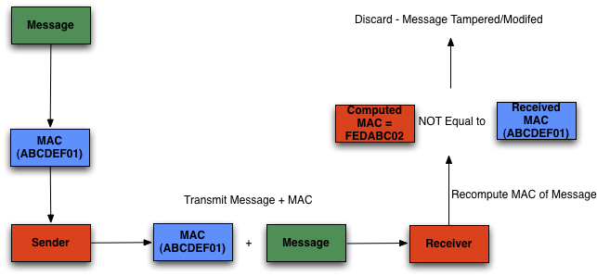
SSL: Integrity
<---------- encrypted ---------->

Slide 50
Record Layer Layer Format
Header (5bytes)
Content Type (1byte):
change_cipher_spec (20)
alert (21)
handshake (22)
application_data (23)
Major Version (1byte):
Major version of SSL
All versions are (3)
Minor Version: (1byte)
Minor version of SSL
SSL v3 (0)
TLS 1.0 (1)
TLS 1.1 (2)
TLS 1.2 (3)
Data Length (2bytes)
Max data length: 18kb
Content
Type
Major
Version
Minor
Version
[Compressed]
Length (16)
Plaintext
(optionally compressed)
Encrypted
MAC
Notes:
Data expansion:
Compression= 1024
Encryption = 1024
2¹⁶ – 2048 = 2¹⁴
Entire payload, including the MAC is encrypted.

Slide 51
Record Layer Protocol Operations
1) Application
Data
2) Fragments
Each fragment
2¹⁴ bytes
3) Compress
Optional Compression
(allow 1024 bytes for expansion)
Not typically used
Compression removed in TLS 1.3 Draft
4) Add MAC
SSL: HMAC-like
TLS: HMAC (e.g., SHA-1 or MD5)
5) Encrypt
Encrypt
(allow 1024 bytes for
expansion)
6) Add SSL
Header
Add SSL Record Layer
header

Slide 52
SSL Handshake Protocol
The beginning of a SSL connection
Protocol within the record protocol
A record can contain several handshake messages
Allows server and client to authenticate one another and establish security parameters
Consists of following phases:
Establish security capabilities
Server authentication and key exchange
Client authentication and key exchange
Finish
Type (1byte)
ClientHello
ServerHello
Certificate
ServerKeyExchange
CertificateRequest
ServerHelloDone
CertificateVerify
ClientKeyExchange
Finished
Type Length Content
1 byte
3 bytes
>= 0 bytes

Slide 53
Handshake Protocol
The handshake protocol is used before any application data is transmitted.
Message Type
Parameters
hello_request
null
client_hello
version, random, session id, cipher suite, compression method
server_hello
version, random, session id, cipher suite, compression method
certificate
chain of X.509v3 certificates
server_key_exchange
parameters, signature
certificate_request
type, authorities
server_hello_done
null
certificate_verify
signature
client_key_exchange
parameters, signature
finished
hash value

Slide 54
Client Hello Parameters
Session ID: An arbitrary byte to identify an active or resumable session
Could be created by using Diffie-Hellman.
Or by the hash of the shared secret and salt.
Version: Identifies highest version number of SSL client can support.
Compression method: The algorithms supported.
Cipher spec: Specifies the bulk data encryption algorithms (such as null, DES, etc.) and a hash algorithms (such as MD5 or SHA-1) supported.
Random Number: 32 byte random number used to seed cryptographic calculations. First four bytes should be date and time.

Slide 55
Server Hello Parameters
Session ID: An arbitrary byte to identify an active or resumable session
Version: Identifies SSL protocol version to be used.
Compression method: The algorithm to be used.
Cipher spec: Specifies the bulk data encryption algorithm and a hash algorithm to be used. Also key size and hash size.
Random Number: 32 byte random number used to seed cryptographic calculations and chosen by server.
Note that whereas client hello components are proposals, server hello components are selections.

Slide 56
Server KeyExchange
Contains key information. Exact contents depend on the specific algorithm being used.
For RSA it would be modulus and public key.
For Diffie-Helman contains server side key message.

Slide 57
ServerHelloDone
Indicates to client server has finished initial negotiation messages.
Message itself contains no other information.

Slide 58
Client KeyExchange
Establishes symmetric encryption key information.
For example, if RSA being used then client generated session key and uses servers public key to encrypt the session key.
Only real server can decrypt to obtain session key.

Slide 59
Finished Message
Allows both sides to verify that negotiation has been successful and security has not been compromised.
Is encrypted and authenticated by the cipher suite just established.
Contains cryptographic hash of important information of just finished negotiation:
Key information
Contents of all previous hash messages exchanged by the systems
Special value indicating client or server
No hash of ChangeCipherState message (see Dropped ChangeCipherState attack)
59

Slide 60
SSL Change Cipher Spec Protocol
Causes pending state to be copied into current state.
Why separate protocol?
Change Cipher Spec protocol notifies the Record Layer protocol to change cipher specifications (keys etc.)
Forces a the next handshake message to use a new record with the new encryption spec

Slide 61
SSL Alert Protocol
Alert Protocol – Used for SSL related alert and error messages Two levels of alerts:
Warnings: Actions not specified in the spec.
Fatal:
Terminate the connection responsible for the alert
Invalidate the session that contained the terminated connection
No new connections allowed using that session, existing connections unchanged
Clients, servers should forget all session information
Closure Alerts:
Client, server should notify each other of connection terminations
Uses close_notify alert
Otherwise, Truncation Attacks are possible
“Defuse the bomb by removing the red wire, after removing the green wire” what if “after removing the green wire” is never received!!!
Security is compromised by terminating the connection prematurely

Slide 62
SSL Encryption
Pre-master Secret
Created by client; used to “seed” calculation of encryption parameters
Very simple: 2 bytes of SSL version + 46 random bytes
Sent encrypted to server using server’s public key
Master Secret
Generated by both parties from premaster secret and random values generated by both client and server
Key Material
A bit stream generated from the master secret and shared random values
Length of the stream may vary depending on negotiated key sizes
Encryption Keys
Extracted from the key material

Slide 63
Security Analysis of SSL
TLS is an extensible framework
TLS been audited by security research and in practice for many years
Flawed algorithms and procedures can be modified with RFCs and extensions
Authentication Issues:
Depends on the validity of certificates and certificate revocation
Unfortunately, there isn't any dependable infrastructure to enforce prudent certification methods
E.g.: Valid certificates issued to false Microsoft, Inc.
IE bug was it failed to validate the entire certificate chain, instead it stopped validation after one parent certificate.
Certificate field “basic constraints” which specifies if the certificate belongs to a CA
Non CAs signing child certificates
SSLsniff – a tool used to exploit this vulnerability
Certificate Revocation Lists (CRLs) not commonly checked by browsers
Key Exchange Issues:
Avoid the use of anonymous Diffie-Hellman dh_anon (MITM attack)
Choice of “strong” public parameters in Ephemeral Diffie-Hellman
Choosing very small prime numbers (like 3 or worst 2!)
Proper padding, salt, and IVs
Using broken or weak algorithms
Using “export” versions with 40-bit key size
Symmetric < 128 bit
Asymmetric and key exchange < 1024 bits
Cipher Spec. Negotiation Issues
Version rollback (SSL v2): Forcing client/server to use a prior less secure version
Algorithm rollback
Dropped Change Cipher Spec Message
Finished message added to stop these attacks
Privacy Issues:
Remote Timing Attacks
Traffic Analysis

Slide 64
Vulnerabilities in SSL/TLS
Physical Attacks
Private keys can be physically stolen from bribery, exploitation, or simply unsecured backups
Does not protect against compromised hosts or application vulnerabilities
Improper validation of certificate fields
No validation “not before” and “not after” is based on client’s time.
Allows an attacker to use an valid expired certificate that’s weaker
User Errors
User ignore certificate warnings
TLS renegotiation vulnerability ( <= SSL 3.0 )
MITM during session negotiation
Bleichenbacher’s Attack
Improper padding, allows attacker to obtain private key in several million messages
One reason why compression is no longer used
BEAST ( <= TLS 1.0)
Chosen plaintext attack to guess the IVs when using CBC
CRIME
Using compression length allows attacker to predict plaintext
One reason why compression is not typically used anymore
SSLStrip
MITM attack that replaces encrypted versions with non-encrypted versions

Slide 65
Man-in-the-Middle Attacks
Installing malicious root CA in user’s certificate store
Commonly done in corporate environments to track user’s Internet usage
Used by several malware
A Simple DoS
Send an invalid SSL packet to the server or client, by predicting subsequent TCP values
SSL will ignore the packet but TCP will accept it
Then, when the real SSL packet comes in TCP will ignore it thinking it is a duplicate and SSL layer will never receive the packet subsequently resulting in a connection termination.
Cipher Spec Rollback
SSL V2 doesn’t do integrity check on ClientHello
So a middle man can change the security parameters to the lowest common denominator in SSL V2
SSL V3 fixes this by authenticating messages
Truncation Attack
SSL V2 depends on TCP FIN|RST for connection termination notification
But, TCP FIN|RST is not authenticated hence anyone can terminate a SSL connection at wish
Making “after removing the green wire” disappear! (See Alert Protocol)

